Slide 1

Classifying
Terms of Services
DSI11 Capstone Project

Slide 2
TABLE OF CONTENTS
01
03
PROBLEM STATEMENT
RESULT ANALYSIS
02
04
METHODOLOGY
CONCLUSION + FUTURE WORK
Why is classifying Terms of Service important?
% improvement on a baseline model
Data Collection | Data Cleaning Preprocessing | Feature Engineering | Modelling
Suggestions to improve this model for better classification

Slide 3
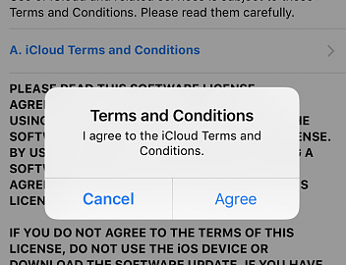
UNDERSTANDING THE PROBLEM
When was the last time you read the terms of service before you accepted one?

Slide 4
UNDERSTANDING THE PROBLEM
91%
of people consent to legal terms and services conditions without reading them
According to a US Deloitte survey of 2,000 consumers

Slide 5
UNDERSTANDING THE PROBLEM
97%
of people from ages 18-34 consent to legal terms and services conditions without reading them
According to a US Deloitte survey of 2,000 consumers

Slide 6
UNDERSTANDING THE PROBLEM
Every cloud app has its rules and regulations
The language is too complex and content is lengthy
Users can't negotiate these terms

Slide 7
UNDERSTANDING THE PROBLEM
Mostly they are used to protect the service company and its users from legal trouble
But there exist a handful of hidden clauses that may take advantage of users
+
-

Slide 8
“ grant to us a non-exclusive, royalty-free, worldwide license to host, use, distribute, modify, run, copy, publicly perform or display, translate, and create derivative works of your content ”
“ analyze your content (including emails) to provide you personally relevant product features ”
INSTAGRAM
GOOGLE
“ We reserve the right to access, read, preserve, and disclose any information as we reasonably believe is necessary ”
“ You waive your right to participate in a class action lawsuit or class-wide arbitration ”
NETFLIX
“ You agree to defend, indemnify, and hold the service harmless in case of a claim related to your use of the service ”
STACKOVERFLOW
“ agree that we may access, store, process and use any information and personal data that you provide ”
LINKEDIN
WHATSAPP

Slide 9
Build a model to scan a Terms of Service or Privacy Policy page to identify unfavourable terms and classify them into categories

Slide 10
The idea is to potentially make these terms of services easier to understand or otherwise improve awareness

Slide 11
WORKFLOW PROCESS
FEATURE ENGINEERING PREPROCESSING
STEP 1
STEP 2
STEP 5
DATA COLLECTION DATA CLEANING
TEST DEPLOYMENT OF TOOL FUTURE WORK
STEP 3
STEP 4
MODELLING
RESULT ANALYSIS CONCLUSIÓN

Slide 12
DATA COLLECTION
DATA SOURCE
Terms of Service; Didn't Read (ToS;DR) website - public database of crowdsourced extracts and reviews
Requested and read in JSON API files available
Collected 2565 data points from the 383 services

Slide 13
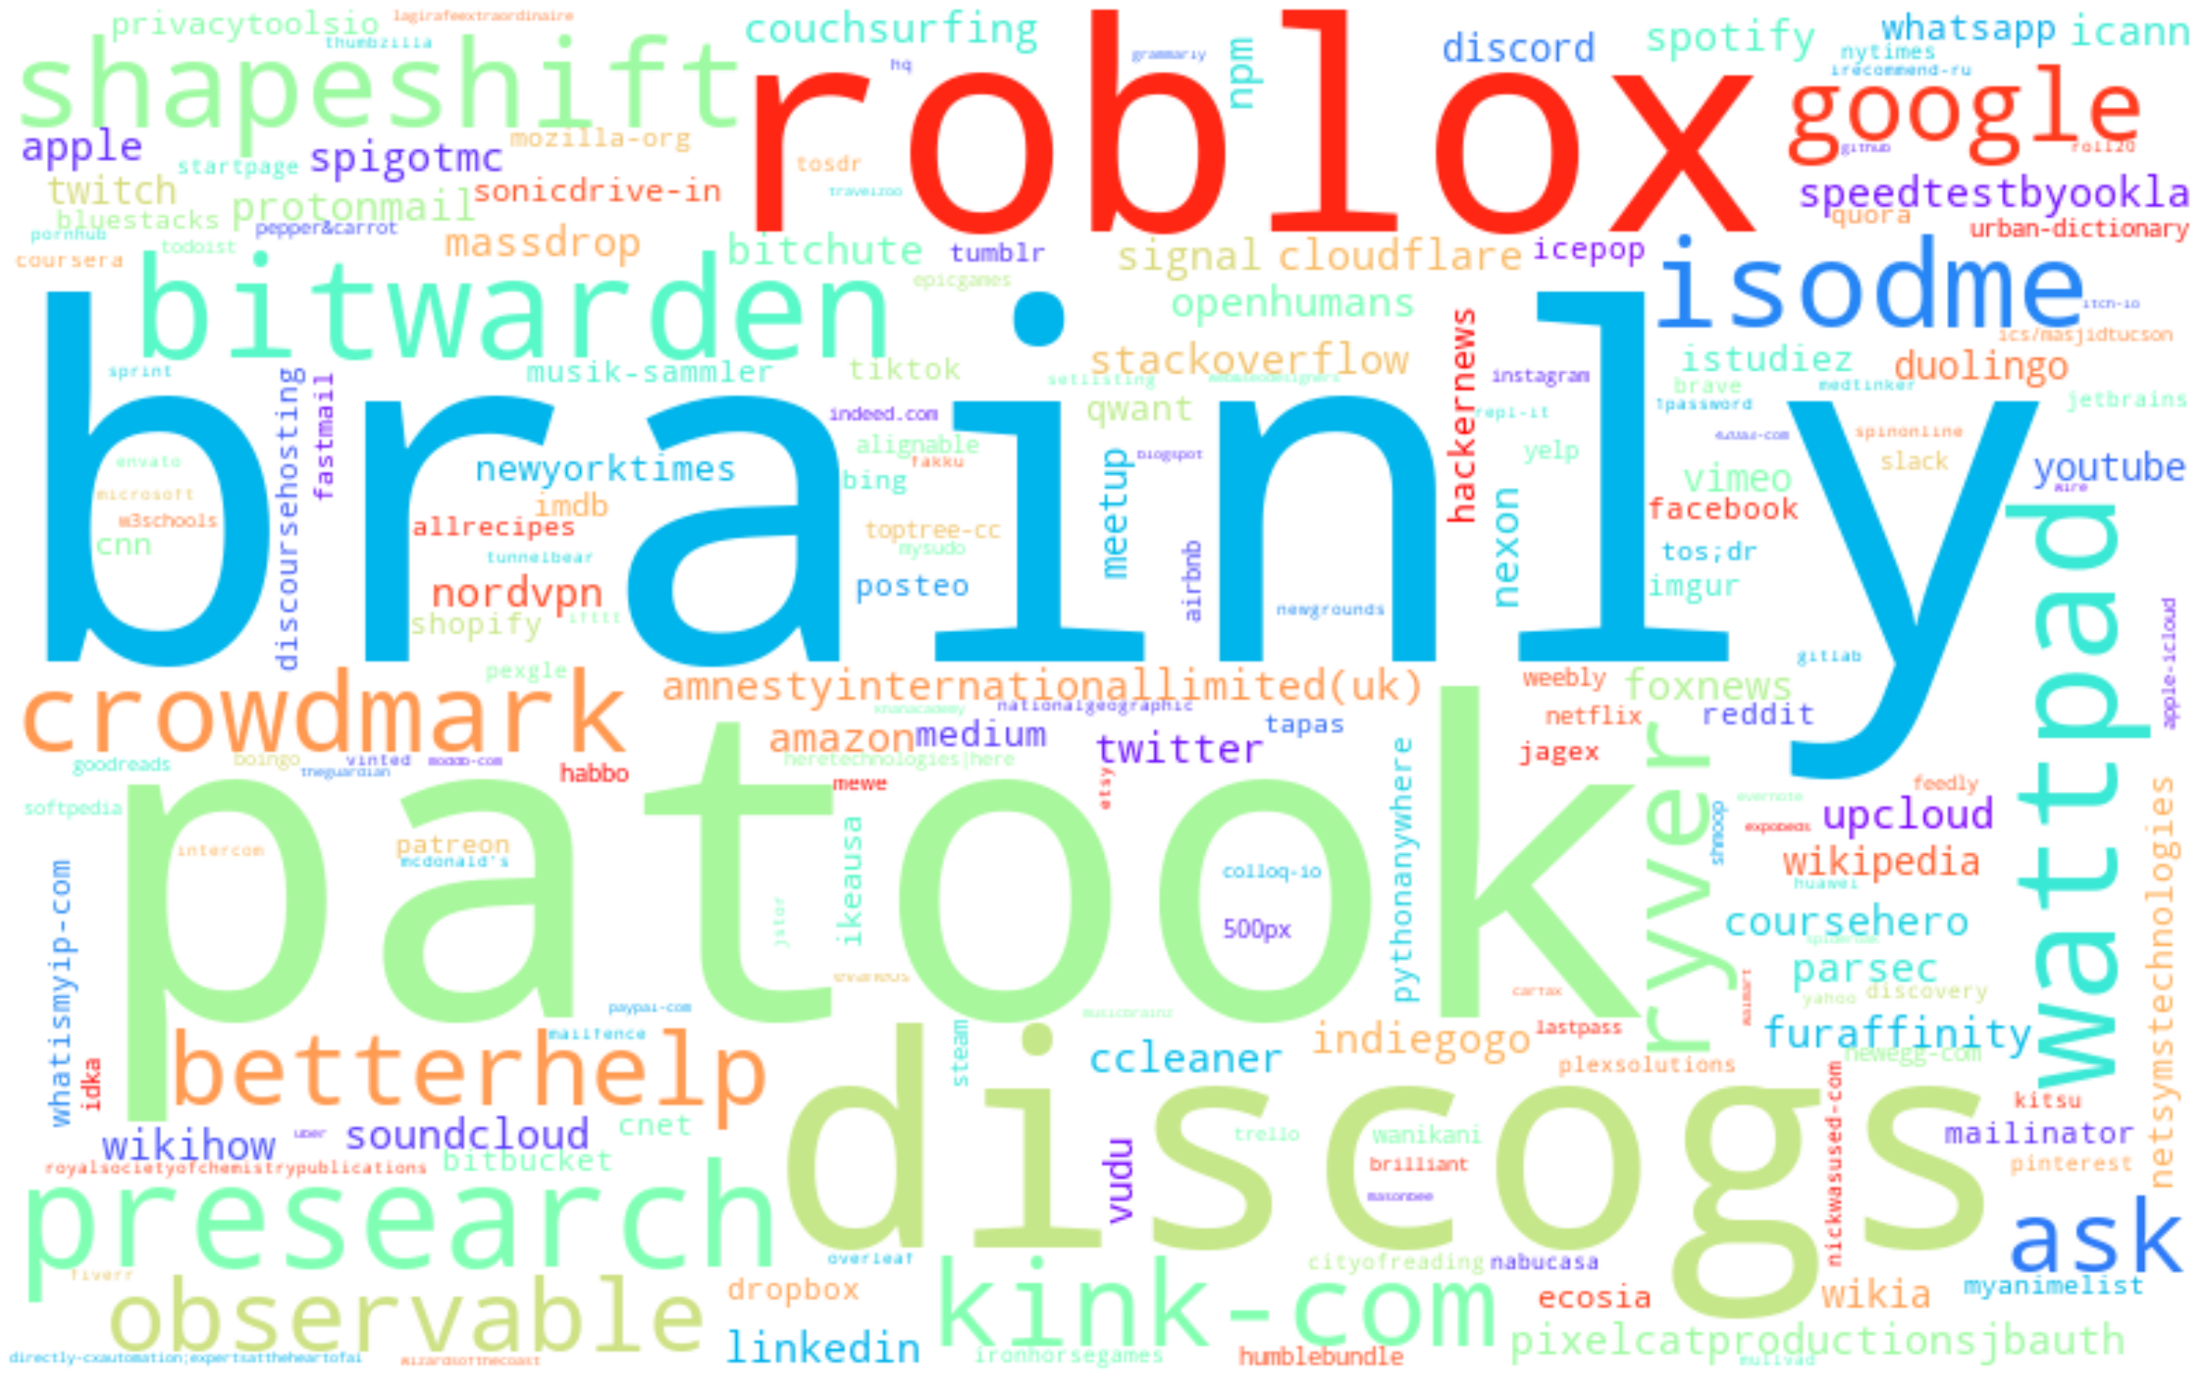
DATA COLLECTION

Slide 14
DATA CLEANING
MISSING DATA
Missing values was prominent throughout the dataset
Missing values had to be filled manually by the most probable value with respective to the already existing values and with reference to ToS;DR website.
IRRELEVANT DATA
Columns with irrelevant values were dropped
Columns with large number of null values were dropped
Values of certain variables were consolidated for consistency
Values of certain variables with insignificant counts were reassigned to suitable prominent ones
Values of certain variable (e.g topics) with low data counts (below 10 counts) were dropped

Slide 15
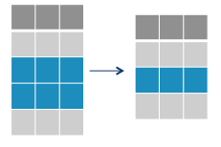
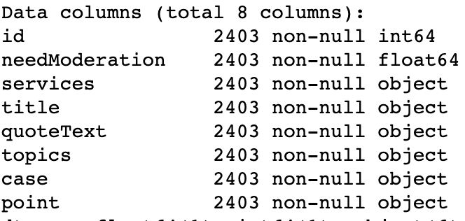
DATA CLEANING
2565 × 18
2404 × 8

Slide 16
DATA CLEANING
TEXT PREPROCESSING
Remove all irrelevant special characters such as any non alphanumeric characters
Tokenize the text by separating it into individual words
Remove words that are not relevant, such as html tags and urls
Convert all characters to lowercase
Do lemmatization to reduce words such as “am”, “are”, and “is” to a common form such as “be”
Repeat the process until no additional errors are spotted

Slide 17
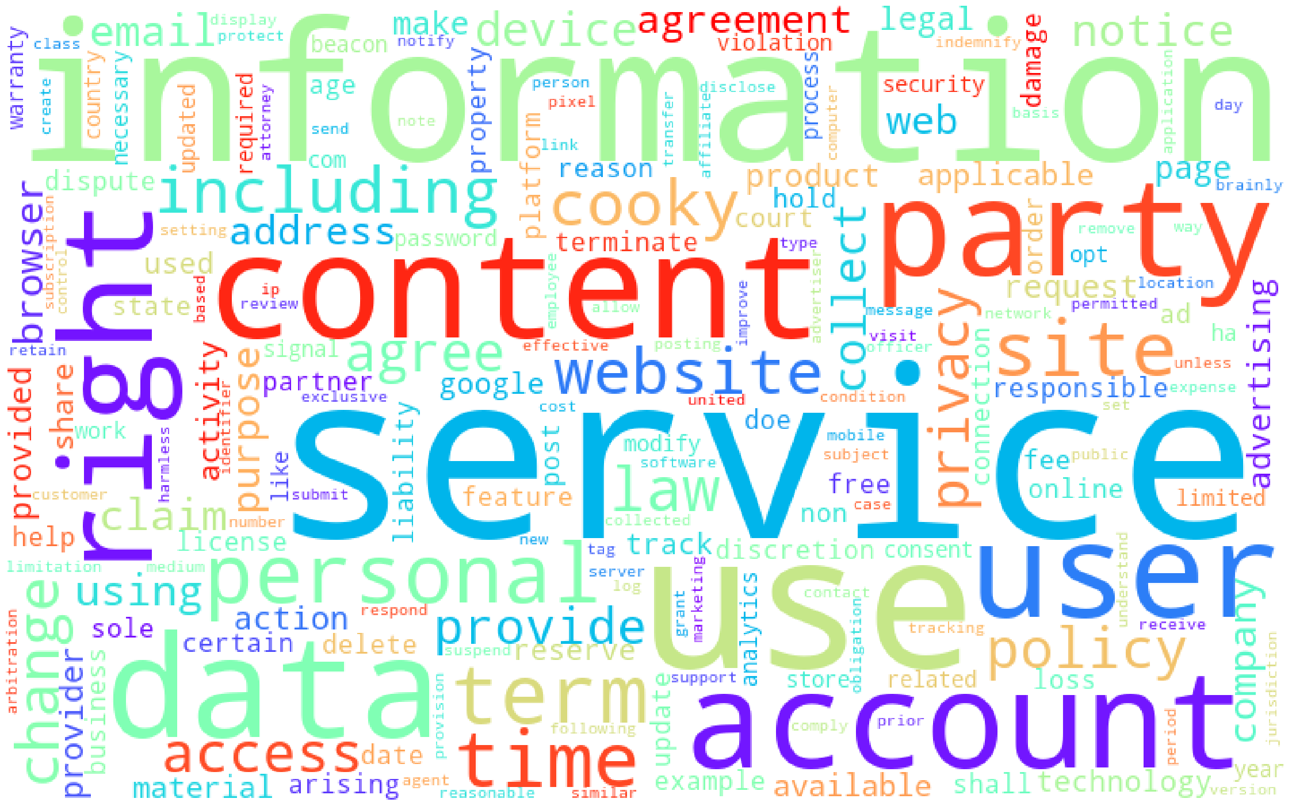
DATA EXPLORATION
Count vectoriser was used to reveal top features in terms of service or privacy policy documents

Slide 18
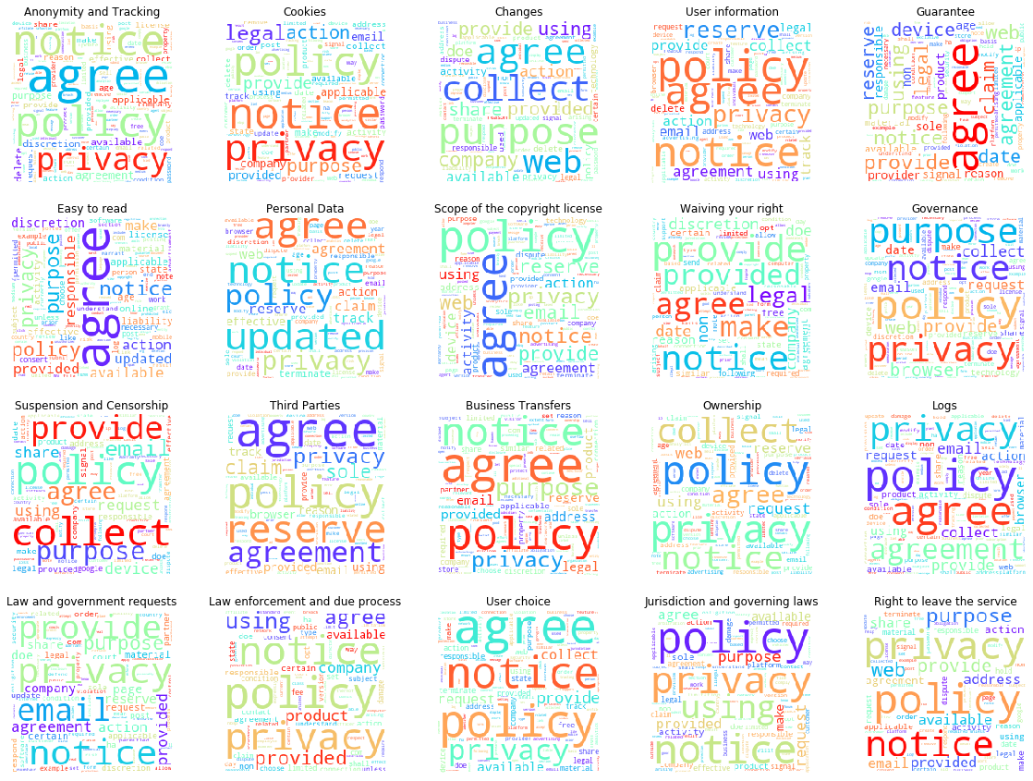
DATA EXPLORATION
Count vectoriser was used to reveal top features by topics

Slide 19
DATA REPRESENTATION
COMPARING BAG OF WORDS MODELS
CountVectorizer vs TfidfVectorizer to vectorize the text data and variables
Compared in Pipeline with a simple Logistic Regression classifier
Best accuracy - precision results (though very small difference) were obtained using TfidfVectorizer
score | CountVectorizer | TfidfVectorizer
accuracy | 0.699 | 0.704
precision | 0.701 | 0.707
recall | 0.699 | 0.704
f1 | 0.691 | 0.679

Slide 20
MODELLING
TOPIC PREDICTION
UNFAVOURABLE TERM PREDICTION
COMBINATION OF TWO NLP CLASSIFICATION MODEL

Slide 21
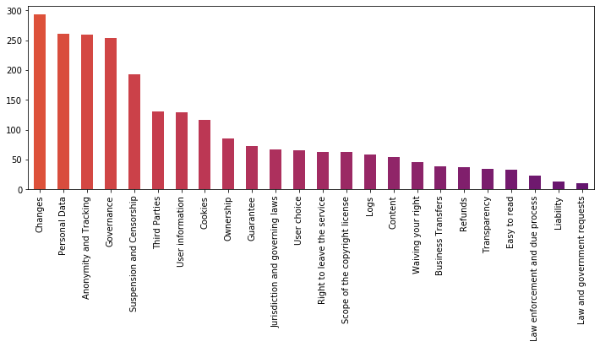
TOPIC
PREDICTION
12.6%
Baseline Accuracy

Slide 22
TOPIC
PREDICTION
classifier chosen is Logistic Regression
STEP 1
STEP 2
STEP 5
text is transformed in a TFiDFVectorizer
find training and testing score
STEP 3
STEP 4
tuned using a GridSearch method measuring on accuracy
best parameters used
Notes:
When first approaching a problem, a general best practice is to start with the simplest tool that could solve the job. Whenever it comes to classifying data, a common favorite for its versatility and explainability is Logistic Regression. It is very simple to train and the results are interpretable as you can easily extract the most important coefficients from the model.

Slide 23
TOPIC
PREDICTION
0.981
0.727
TRAINING SCORE
TEST SCORE
Notes:
Training score is 0.981 which indicates that overfitting. This is common in NLP as the model is fitting random idiosyncrasies in the training data rather than model the true underlying trends. Thus, looking at the test score will be of better significance.
Test score is 0.727 which is a good score conveys that the model is performing well enough. This score implies that out of 100 instances, the model correctly predicts the topic 72.7 % of the time.

Slide 24
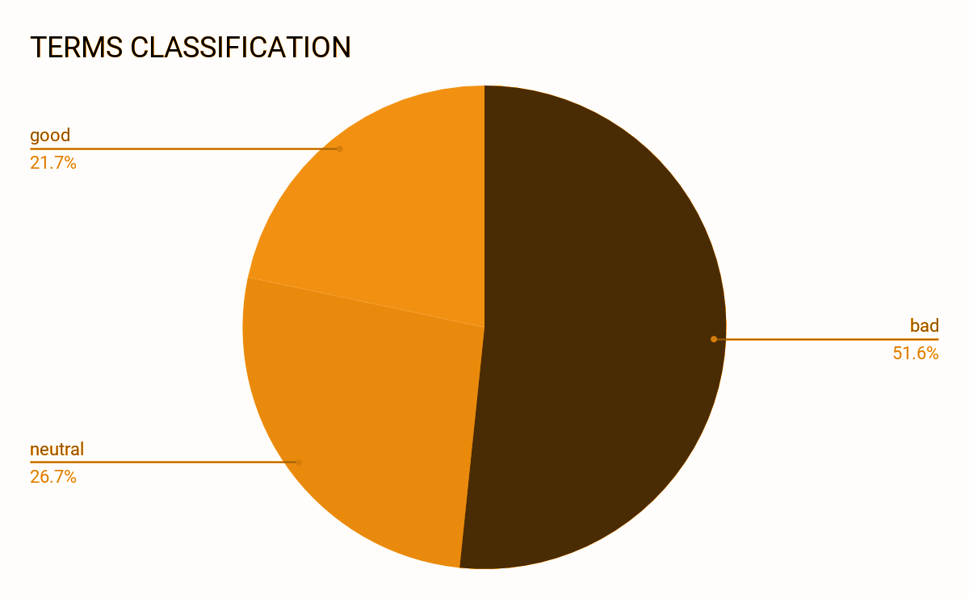
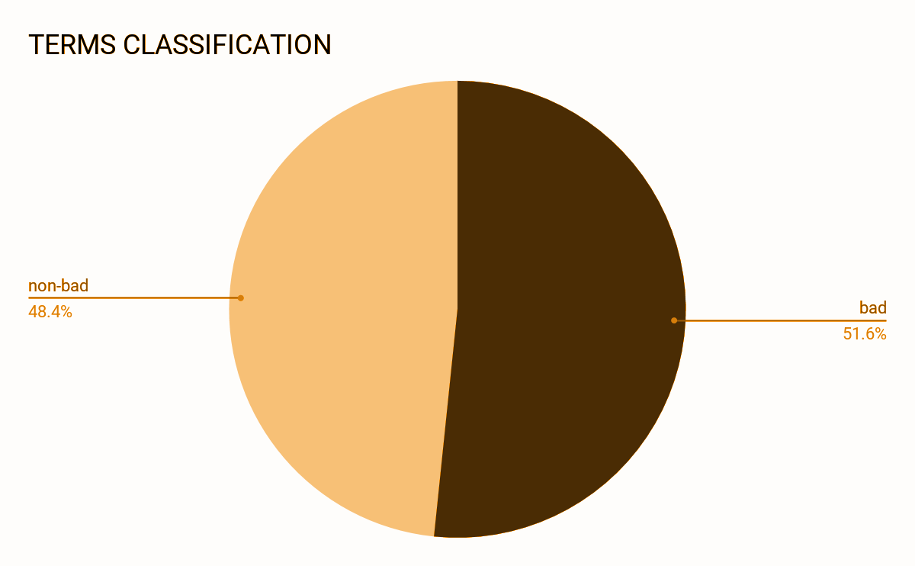
UNFAVOURABLE TERMS
PREDICTION
51.6%
Baseline Accuracy

Slide 25
UNFAVOURABLE TERMS
PREDICTION
different classifier models and its precision scores were compared
STEP 1
STEP 2
STEP 5
TFiDFVectorizer was chosen for preprocessing
find training and testing score
STEP 3
STEP 4
classifier chosen is Random Forest
tuned using a GridSearch and best parameters used
Notes:
Precision will be a good measure to determine when the costs of False Positive is high. For this case, a false positive means that a term of service that is subjected to be of warning is being identified as non-warning.
The user may overlook this term of service and agree to accept them without knowing any wiser.

Slide 26
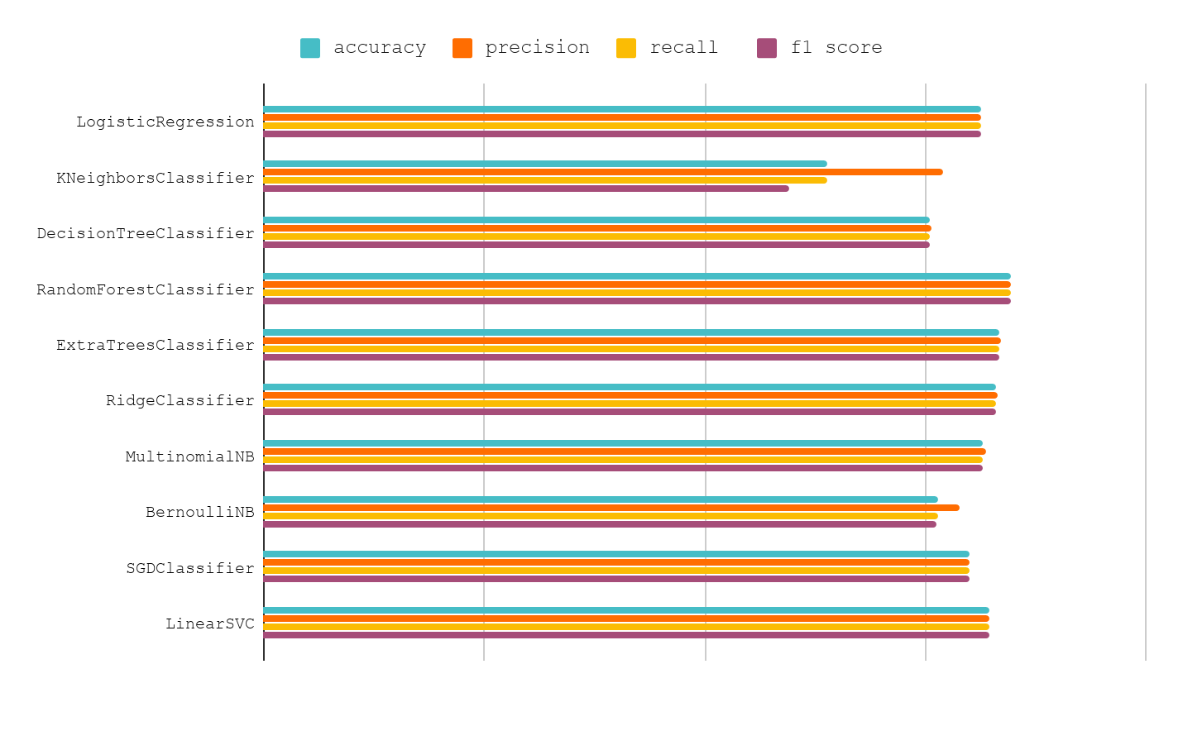
UNFAVOURABLE TERMS
PREDICTION
accuracy = 0.840 precision = 0.841 recall = 0.840 f1 = 0.840

Slide 27
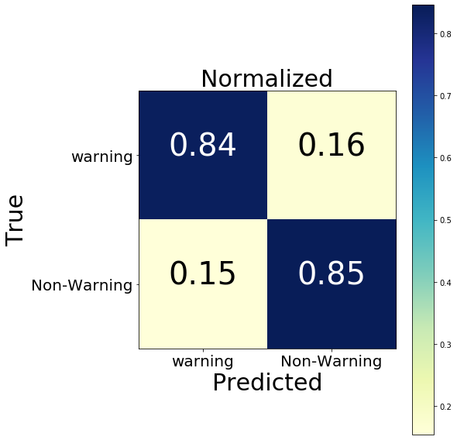
UNFAVOURABLE TERMS
PREDICTION
Notes:
Confusion Matrix was computed to give a summary of prediction results on this classification problem.
The prediction model accurately predicts:
84% for warning terms
85% for non- warning terms

Slide 28
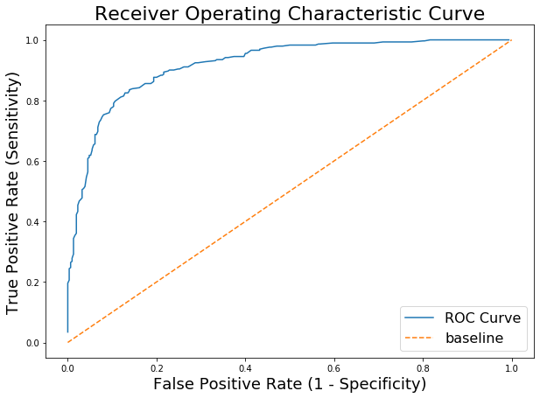
UNFAVOURABLE TERMS
PREDICTION
Notes:
ROC Curve shows the tradeoff between sensitivity and specificity of our model which in this case loosely means that how good the model can distinguish.
The AUC (the area under the ROC curve) seems to be large enough therefore this show that our model is doing a good job of distinguishing the positive and the negative values.
Since our model is performing well enough, we are well convinced to move forth with it.

Slide 29
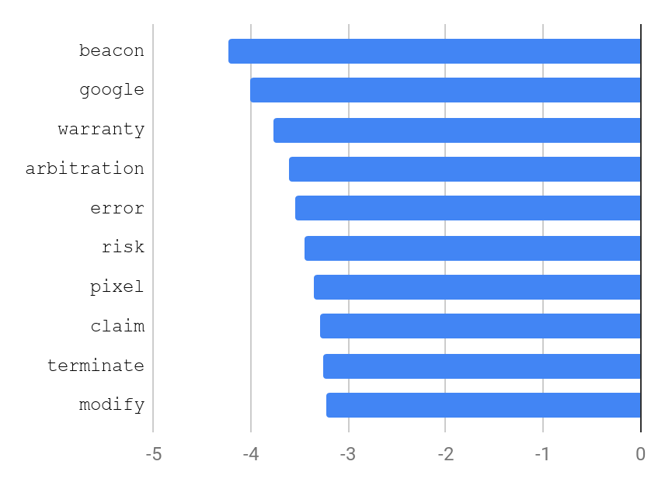
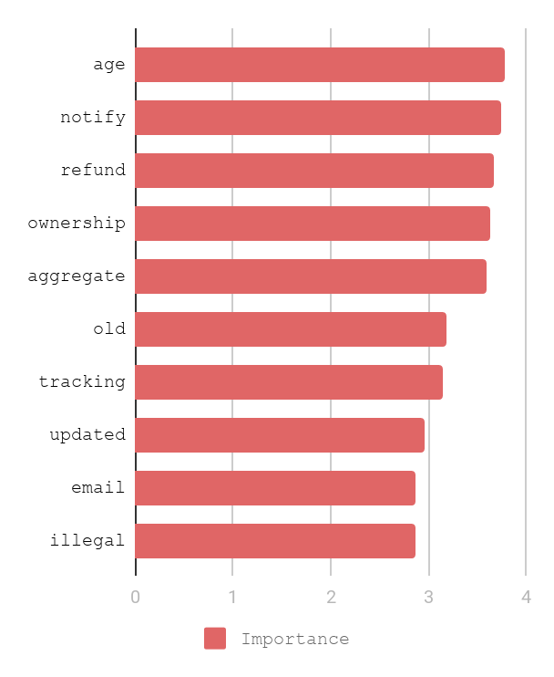
UNFAVOURABLE TERMS
PREDICTION
Important words for warning terms
Important words for non-warning terms

Slide 30
UNFAVOURABLE TERMS
PREDICTION
12 Wrongly Predicted

Slide 31
UNFAVOURABLE TERMS
PREDICTION
e.g.
“If our organizational structure or status changes (if we undergo a restructuring, are acquired, or go bankrupt) we may pass your information to a successor or affiliate” Classified as: Business Transfers Predicted as: Changes Predicted as non-warning?: 1
“In order to view, amend, erase, or correct your Collected Information, contact Plex support” Classified as: Personal Data Predicted as: Right to leave the service Predicted as non-warning?: 0
“By registering for an account, you further agree to (a) provide accurate, truthful, current and complete information” Classified as: Transparency Predicted as: Anonymity and Tracking Predicted as non-warning?: 0

Slide 32
LIMITATIONS + CONCLUSION
LIMITATIONS
Inaccurate classification or summarization in the dataset
Wrongly predicted topics and unfavourable terms classification
Requires a clear segmentation format of terms of service url page to be presented for better prediction and classification
CONCLUSION
The model was able to achieve an accuracy rate of 72.7 % in predicting one out of twenty-four subject topics, against a baseline of 11%
The model was able to achieve AN accuracy rate of 84% in predicting unfavourable (warning) terms, against a baseline of 51.6%

Slide 33
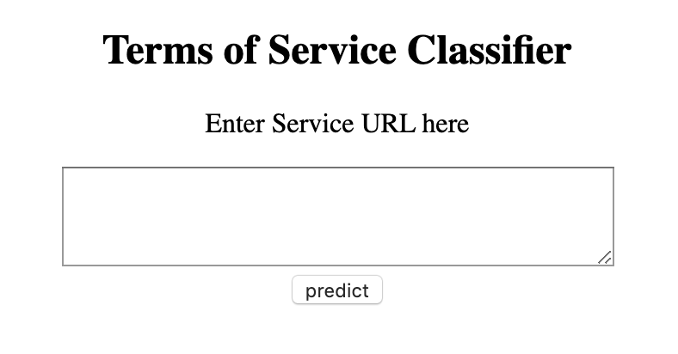
WEB APPLICATION TOOL
Enter the terms of service or privacy policy URL of desired service to find out whether it is 'GOOD TO GO' or 'WARNING: YOUR ATTENTION REQUIRED' and the dropdown of warning terms
Notes:
The threshold is currently set to 0.8 for a stringent analysis of unfavourable terms. This threshold can be amended according to user preference and/or business requirements

Slide 34

WEBSITE
Notes:
The threshold is currently set to 0.8 for a stringent analysis of unfavourable terms. This threshold can be amended according to user preference and/or business requirements

Slide 35
FUTURE WORK
Further be improved on
Develop a neural network model with a specialized word embedding layer
Sentiment analysis
Deciding on a threshold (warning or non-warning) for each specific categorical service so that the analysis could be more precise
Refining the accuracy-precision further through additional data, model tuning and re-evaluation of the classification framework
Further improvement on the front-end user application
Notes:
LDA
Encoder-Decoder (LSTM) - Summarization of text?

Slide 36
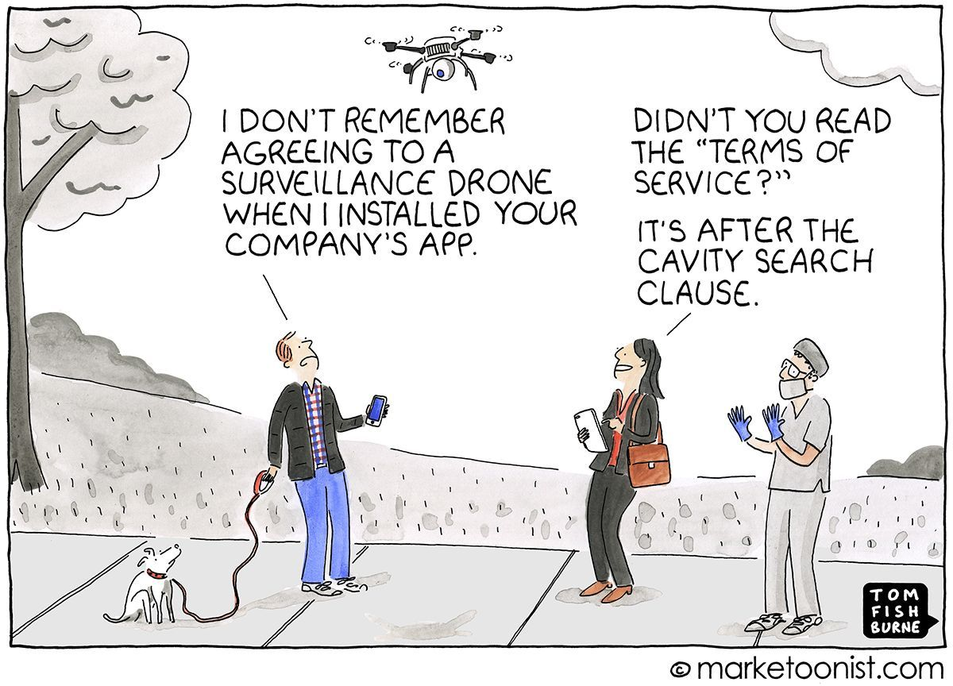
THANK YOU
I WILL TAKE QUESTIONS NOW

